Slide 1
PMP® Exam Preparation
B. M. Shahrier Majumder, PMP

Slide 2
Project Cost Management

Slide 3
Learning Objectives
Upon completion of this topic you will learn about
  The processes, activities and documentation items for Project Cost Management
  Elements (and deliverables) for Project Cost Management
  Tools and techniques of the key activities of the Project Cost Management

Slide 4
Cost Management
Project Cost Management includes the processes involved in planning, estimating, budgeting and controlling costs so that the project can be completed within the approved budget.

Slide 5
Key Activities of Cost Management
Estimate Cost: The process of developing an approximation of the monetary resources needed to complete project activities.
Determine Budget: The process of aggregating the estimated costs of individual activities or work packages to establish an authorized cost baseline.
Control Cost: The process of monitoring the status of the project to update the project budget and managing changes to the cost baseline.

Slide 6
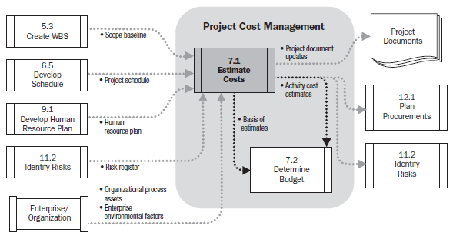
Estimate Cost | Data Flow Diagram

Slide 7
Estimate Cost
Inputs |  | Tools & Techniques |  | Outputs
Scope baseline Project schedule Human resource Plan Risk register Enterprise environmental factors Organizational process assets |  | Expert judgment Analogous estimating Parametric estimating Bottom-up estimating Three point estimating Reserve analysis Cost of quality Project management estimating software Vendor bid analysis |  | Activity cost estimates Basis of estimates Project document updates

Slide 8
Estimate > Inputs
Enterprise Environmental Factors
    Market place condition
    Commercial database
Organizational Process Assets
    Cost estimating policies
    Cost estimating templates
    Historical information
    Project knowledge database
    Lesson learn database

Slide 9
Estimate Cost > Tools and Techniques
Bottom-up estimating
    Estimates made at the work-package of the WBS and rolled up
    Very accurate
    Needs sufficient information to make an accurate estimate
Vendor Bid Analysis
    Analysis of what the project should cost, based on the responsive bids from qualified vendors. Where project are awarded to a vendor under competitive processes , additional cost estimating work can be required of the project team to examine the price of individual deliverables and to deliver the cost that supports the final total project cost.

Slide 10
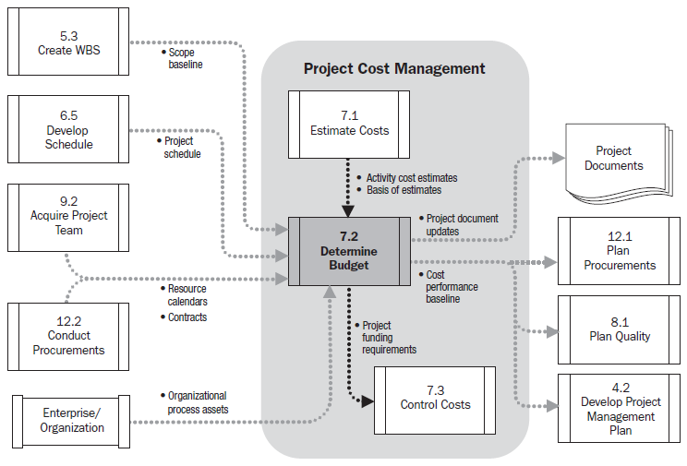
Determine Budget | Data Flow Diagram

Slide 11
Determine Budget
Inputs |  | Tools & Techniques |  | Outputs
Activity cost estimates Basis of estimates Scope baseline Project schedule Resources calendars Contract Organization process assets |  | Cost aggregation Reserve analysis Expert judgment Historical relationships Funding limit reconciliation |  | Cost performance baseline Project funding requirements Project document updates

Slide 12
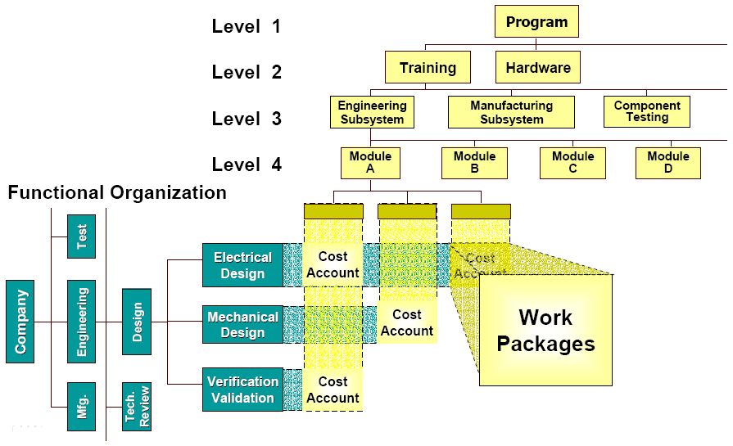
Determine Budget > Tools and Techniques
Cost Aggregation

Slide 13
Determine Budget > Tools and Techniques
Funding Limit Reconciliation
    The expenditure of funds should be reconciled with any funding limit of the commitment of funds for the project.
    A variance between funding limits and the planed expenditures will sometimes necessitate the rescheduling of work to level out the rate of expenditures.

Slide 14
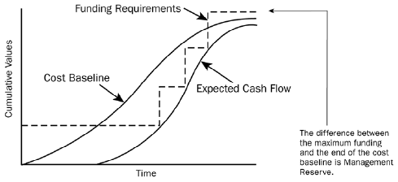
Determine Budget > Outputs
Cost Performance Baseline
  A time-phased budget that is used to measure and monitor cost performance on a project
  The approved cost estimates
  Displayed graphically as cumulative costs over time
  Displayed as an S-Curve
Funding Requirements
  Total and periodic funding requirements, are derived from the cost baseline and can established to exceed, usually by a margin to allow for either early progress or cost overrun.

Slide 15
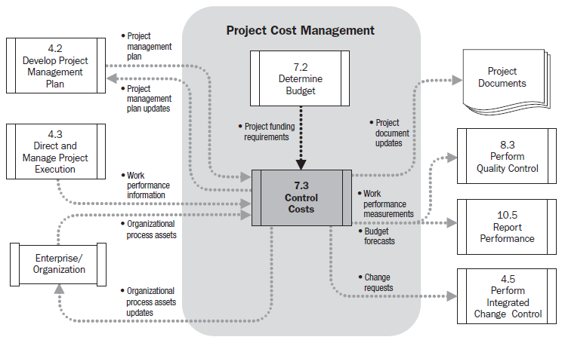
Control Costs

Slide 16
Control Costs
Inputs |  | Tools & Techniques |  | Outputs
Project management plan Project funding requirements Work performance information Organizational process assets |  | Eared value management Forecasting To complete performance index Performance reviews Variance analysis Project management software |  | Work performance measurements Budget forecasts Organizational process assets updates Change requests Project management plan updates Project document updates

Slide 17
Control Cost > Tools and Techniques
Earned Value Management (EVM)
    EVM in its various forms is a commonly used method of performance measurement. It integrates project scope, cost and schedule measures to help project management team assess an measure project performance and progress.
    EVM develops and monitors three key dimensions of each work package and control account. These are Planned Value (PV), Earned Value (EV) and Actual Cost (AC).

Slide 18
Control Cost > Tools and Techniques
Terms to be remember:
Abbr. | Name | Formula
BAC | Budget at Completion | How much did we budget for the TOTAL project effort?
PV | Planned Value | What is the estimated value of the work planned to be done as of now?
EV | Earn Value | What is the estimated value of the work actually accomplished as of now?
AC | Actual Cost | What is the actual cost incurred for the work accomplished?
CV | Cost Variance | Currently project is over budgeted or under budgeted?
SV | Schedule Variance | Currently project is ahead of schedule or behind of schedule?
CPI | Cost Performance Index | How much worth of work we are getting out of every $1 spent.
SPI | Schedule Performance Index | What is our progress at percent of the rate originally planned?
EAC | Estimate at Completion | What do we currently expect the TOTAL project to cost?
VAC | Variance at Completion | How much over or under budget do we expect to be at the end of the project?
ETC | Estimate to Complete | From this point of now, how much more do we expect it to cost to finish the project?

Slide 19
Control Cost > Tools and Techniques
Earned Value Analysis
Abbr. | Name | Formula | Good | Bad
EV | Earn Value | BAC x Percent Complete | NA | NA
PV | Planned Value | BAC x Percent Duration | NA | NA
CV | Cost Variance | EV-AC | +ve | -ve
SV | Schedule Variance | EV-PV | +ve | -ve
CPI | Cost Performance Index | EV/AC | >1 | <1
SPI | Schedule Performance Index | EV/PV | >1 | <1
CV% | Cost Variance Percentage | CV/EV | +ve | -ve
SV% | Schedule Variance Percentage | SV/PV | +ve | -ve
EAC | Estimate at Completion | BAC/CPI | <BAC | >BAC
VAC | Variance at Completion | BAC-EAC | +ve | -ve
ETC | Estimate to Complete | EAC-AC | NA | NA

Slide 20
Control Cost > Tools and Techniques
Exercise
  Total Budget = $2975
  % Duration complete: 60%
  % Complete = 59%
  Actual Cost = 1575
  Find out the all values as per EVM formula table.

Slide 21
Project Selection Method
Present Value
Net Present Value
IRR (Internal Rate of Return): The rate at which the project inflows (revenue) and outflows (cost) are equal.
Payback Period
Benefit Cost Ratio

Slide 22
Cost Management > Some Important Definition
Present Value: The value of future cash flows
  Formula (PV = (FV/(1+r)^{n} [ Here, PV = Present Value, FV = Future Value, r = Interest Rate, n = Number of time periods]
Net Present Value: The difference between the present value of cash inflows and the present value of cash outflows.
IRR (Internal Rate of Return): The rate at which the project inflows (revenue) and outflows (cost) are equal.

Slide 23
Cost Management > Some Important Definition
Payback Period: The number of time periods it takes to recover your investment in the project before you start accumulating profit.
Benefit Cost Ratio: Benefit cost ratio > 1 means the benefits are grater than the costs.
Sunk Cost: Money already spent and permanently lost.

Slide 24

Questions
[mail.shahrier@gmail.com]
http://bd.linkedin.com/in/shahrier

